Slide 1
Western Civilization to 1500
Lecture 28: The Byzantine Empire

Slide 2
Background
East/West split in the 4th century
  Western capital: Rome
  Eastern capital: Constantinople
Barbarians invade the West
Eastern empire continues to thrive

Slide 3
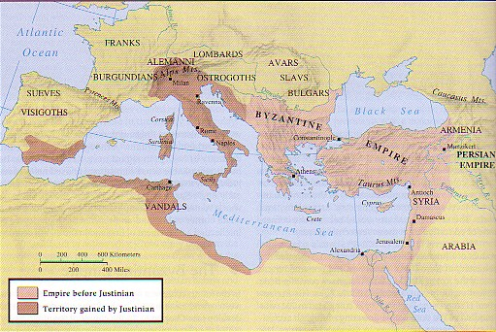
Justinian’s Reign
Ruled 527-565
Theodora
Belisarius and Western campaigns
  533 – N. Africa
  535 – Sicily
  552 – Italy
Overextension or plague?

Slide 4
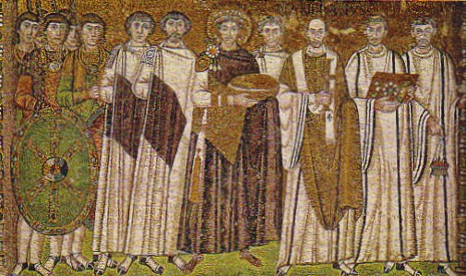
Justinian’s Reign (2)
Corpus Iuris Civilis
  Codex
  Digest (encyclopedia)
  Institutes (textbook)
  Novels

Slide 5
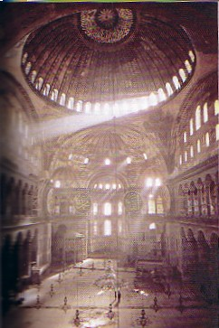
Justinian’s Reign (3)
Procopius (500-562)
  Wars
  Secret History
Constantinople
  532 – Nike Revolt
  Commercial nexus
  Buildings
    Hippodrome
    Hagia Sophia (537)

Slide 6
Transition Period
Eastern Roman Empire ➔ Byzantine Empire
  7th-century Invasions (Persians, Slavs, Arabs, Bulgars)
  Heraclius (610-641) and the theme system

Slide 7
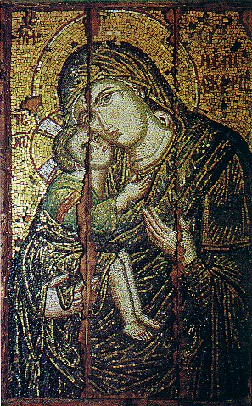
Eighth Century
Reduced territory
Latin ➔ Greek
Christian foundation
  Buildings and art
  Caesaro-papism
  Religious controversy
Iconoclasm
  Leo III (717-741)

Slide 8
Influence
Powerful idea of Empire, Rome
Legal system
Buffer state
Constantinople legendary in the West
Example of Christian empire

