Slide 1
Western Civilization to 1500
Lecture 27: Early Church Fathers and Monasticism

Slide 2
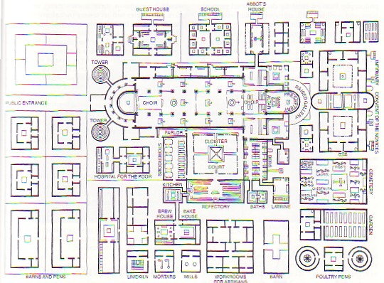
Early Monasticism
Scriptural foundations
  Poverty
  Celibacy
Influence of Neo-Platonism
Types of monasticism
  Eremitical
  Cenobitical
Martyrs ➔ Monks

Slide 3
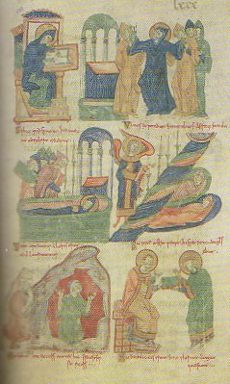
Benedictine Rule
Benedict of Nursia (480-543) – noble
Monte Cassino
Monastic Rule
  Pray
  Work
  Sleep

Slide 4
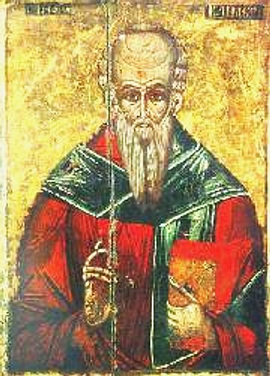
Alexandrian School
Clement of Alexandria (c.150-c.215)
  Platonist
  Christianity completes pagan philosophy
Origen (c.185-c.254)
  Textual critic
  Allegory
  Martyrdom

Slide 5
Augustine, Bishop of Hippo
(354-430 A.D.)
Early years, Manichaeism
Influence of Monica, Ambrose
Conversion experience: “tolle lege”
Author of The Confessions; City of God
Leading Theologian of the Western Church
Notes:
Augustine’s conversion experience involved an occurrence in the garden at his house. He heard a child’s voice on the other side of the wall crying repeatedly “tolle lege”; “take up and read.” Augustine picked up the N.E. and at random lighted on Rom. 13:13, 14 which sealed his moral conversion.

Slide 6
Augustine (cont.)
Two Cities: City of Man vs. City of God
The church is an admixture of the elect and the reprobate
Depravity of human nature

Slide 7
Athens and Jerusalem
What is the proper relationship between Christianity and classical culture?
Compatibility
  Alexandrians
  Augustine
Antagonism
  Tertullian (c.160-c.220)
  Jerome (347-420)

