Slide 1
Western Civilization to 1500
Lecture 26: Official Christianity

Slide 2
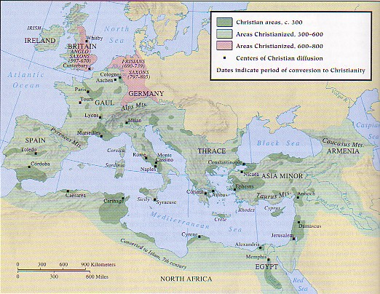
Early Church Concerns
Conversions and missionary activity
Organization
  Bishops and dioceses
  Metropolitans/Exarchs

Slide 3
Heresies, Councils, Creeds
Major Early Christian Heresies
  Docetism
  Gnosticism
  Marcionites
  Donatism
  Arianism
Creeds and Councils
  Apostles Creed
  Nicene Council (325) and Creed

Slide 4
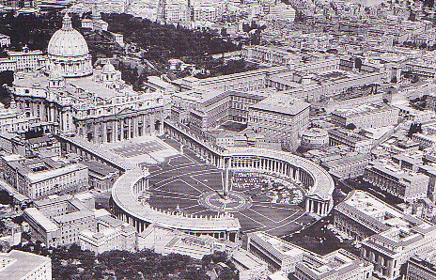
Papal Authority
Doctrine of Petrine supremacy
Damasus (366-384)
Leo I (440-461) and the Council of Chalcedon (451)

Slide 5
Church and State
Role of emperors in the church
Role of bishops in the government
Church’s struggle for independence
  Ambrose (339-397) vs. Theodosius
  Gelasius I (492-496)

