Slide 1
Western Civilization to 1500
Lecture 24: Roman Empire: 3rd-Century Crisis

Slide 2
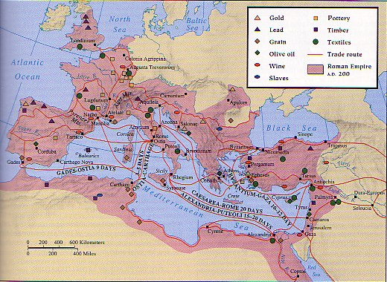
The Empire’s Peak
3.5 million sq miles
50 million people
Defensive policy beginning 2nd century
Frontier weaknesses
Dilution of army
Notes:
Roman expansion ended in the 2nd century A.D.; from that point the foreign policy was defensive in nature, attempting to guard the frontiers. The army gradually was made up more and more of non-Italian troops who were of lesser quality and less reliability.

Slide 3
Economy
Role of cities
  Rome
  Alexandria
  Ephesus
  Antioch
Trade and trade routes
Agriculture
  Latifundia
  Coloni
Notes:
Cities served as vital hubs of culture and commerce; the four listed above were the largest in the empire. Trade was extensive in the 2nd century; Tin from Cornwall was consumed in Syria, for example. The division of labor reached what probably its highest level to that point in world history.
Despite the advanced division of labor, agriculture remained the occupation of most people. Latifundia, or large landed estates, dominated agriculture; these estates employed slaves primarily but also coloni, or tenant farmers.

Slide 4
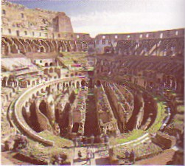
Imperial Rome
Living conditions
Fire of 64
Public buildings
“Bread and Circuses”
Gladiatorial shows, public executions
Notes:
Rome was crowded, noisy, and stinky. The poor lived in insulae, or apartment blocks, which could be six stories high. These buildings were made of wood and concrete and could catch fire fairly easily. The fire of 64 destroyed much of the city.
At least the Romans enjoyed the finest public buildings in the world: temples, for a, theaters, baths, markets, etc.

Slide 5
“Terrible Third Century”
Instability after 180
  Commodus (180-192)
  Septimius Severus, Severan dynasty (193-235)
Military anarchy (235-284)
  22 emperors in 50 years; 20 died violently
  Capture of Valerian (253-260) by Persians
  Germanic invasions
  Population decline, economic collapse
Notes:
Marcus Aurelius’s son Commodus broke the string of capable rulers. After earning the hatred of the people and the army in his 12-year rule, he was assassinated. The ensuing civil war ended when Septimius Severus, a general, seized power. His motto was “pay the soldiers, and ignore everyone else.” In other words, an emperor’s foremost concern was to maintain the loyalty of the troops.
Severus’s descendants ruled until 235, at which point a period of military anarchy ensued. The emperor Valerian’s capture by the Persians and subsequent death in captivity, an unprecedented event in Roman history, was symbolic of Rome’s decline. Germanic tribes (Goths, Franks, Alemanni) also began pouring over the Roman frontiers at this time.

Slide 6
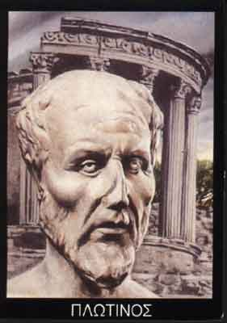
Neo-Platonism
3rd-century development
Universe emanates from “the One”
Contemplative ideal
Plotinus (204-270) and the Enneads
Influence

