Slide 1
Western Civilization to 1500
Lecture 23: Spread of Christianity

Slide 2
Persecutions
Romans initially ignored Christians
Gradual change of view
  Rumors of ritual murder, etc.
  Viewed as a threat to public order, traitors
  Romans 13
Sporadic attacks in 1st and 2nd centuries
  Nero’s and Domitian’s persecutions
  Pliny the Younger on Christians

Slide 3
Ignatius of Antioch (50-98?)
Wrote epistles to several churches
Emphases
  Church as a community
  Authority of church leaders
Martyred in Rome
Notes:
Polycarp authored letters to the following places: Magnesia; Tralles; Rome; Philadelphia; Smyrna; and to the person Polycarp
The main teachings of his letters—the Church was established by God as a visible community, the ultimate purpose is the salvation of souls, apostates are cut off from God (Philad.,); the order and nature of the leadership of the Church instituted by Christ (lntrod. to Philad.; Ephes., Magn.,); the unity, holiness, and universal nature of the Church (Trall., Philad., Magn., Smyrn., Ephes., and Rom.); the doctrine of the Lord’s Supper; the Incarnation (Ephes.,); the covenantal nature of marriage (Polyc., ); prayer (Ephes.,); he denounces the doctrine of private religion and he condemns the false teachings of Docetism and the practice of Judaizing

Slide 4
Polycarp (69-155?)
Bishop of Smyrna
Probably knew the apostle John
Fought early heresies, esp. the Marcionites
Martyrdom
Notes:
Polycarp among the earliest Christians whose writings survive. Probably knew John the apostle,
He died with an unyielding faith in Jesus
Polycarp was the bishop of the church at Smyrna fought early heresies including the teachings of Marcion,
Wrote a letter to the Philippians
Irenaeus was his disciple, and tells us that "Polycarp was instructed by the apostles, and was brought into contact with many who had seen Christ" (Adv. Haer., iii. 3; Euseb. Hist. Eccl., iv. 14).

Slide 5
“Epistle of Barnabas”
Written in late 1st century A.D.
Utilizes extensive allegory
Explicitly condemns abortion/infanticide
Distances Christianity from Jewish practice
Notes:
The writer of this epistle—supposedly an Alexandrian Jew of the times of Trajan and Hadrian. Associated with the one with Paul in Acts, but it is more probable that the epistle, being anonymous, was simply attributed to this Barnabas.
The epistle is characterized by the use of exaggerated allegory.
Written after the destruction of Jerusalem—reference is made to that event (16:3-4)
Main purpose of the letter—1:6, 7 There are then three doctrines of the Lord: "the hope of life" is the beginning and end of our faith; and righteousness is the beginning and end of judgment; love of joy and of gladness is the testimony of the works of righteousness. For the Lord made known to us through the prophets things past and things present and has given us the first fruits of the taste of things to come; and when we see these things coming to pass one by one, as he said, we ought to make a richer and deeper offering for fear of him.
Early church reference against abortion—"You shall not slay the child by procuring abortion; nor, again, shall you destroy it after it is born." (19:5)

Slide 6
3rd Century Growth
Reasons
  Promise of eternal life
  Some similarities to mystery religions?
  Jesus was human, not mythological
  Universal appeal; open to all
  Holy Spirit

Slide 7
Legitimacy
Fierce 3rd-century persecutions
Constantine (306-336)
  Battle of Milvian Bridge (312)
  Edict of Milan (313)
Theodosius I (378-395)

Slide 8
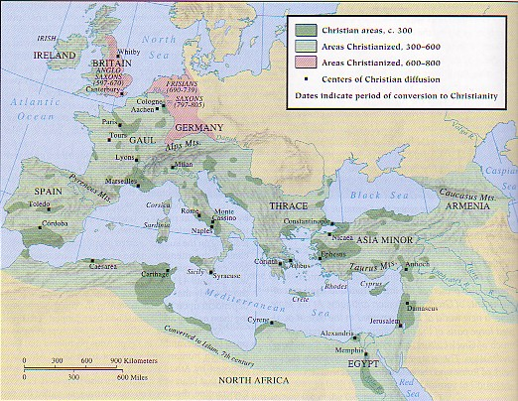
Early Church Concerns
Conversions and missionary activity
Organization
  Bishops and dioceses
  Big Four (later Five)
Heresies
  Donatism
  Arianism
  Nicene Council (325)
Notes:
“Big Four” cities of early Christianity were Jerusalem, Rome, Alexandria, and Antioch. Constantinople later rose to prominence as well. The bishops of these cities came to be known as “patriarchs” of the church.

