Slide 1
Western Civilization to 1500
Lecture 21: The Golden and Silver Ages of Latin Literature

Slide 2
Period Classifications
Mythical ages of man (Hesiod, Ovid)
Wilhelm Sigismund Teuffel (1870)
Classification according to politics
  Golden Age (Late Republic, Augustus)
  Silver Age (Pax Romana after Augustus)

Slide 3
Lyric Poets
Catullus (84-54)
  Influenced by Hellenistic styles
  Most famous for love poems: Clodia/“Lesbia”
Horace (65-8)
  Greatest Roman lyric poet
  Odes and Epodes: love, friendship, simple life
  New genre: the satire
  English model

Slide 4
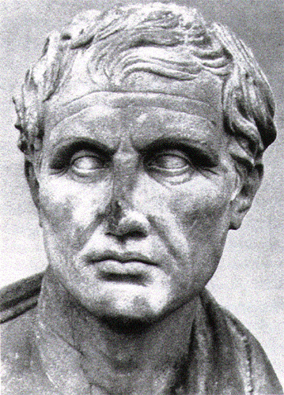
Vergil (70-19)
Greatest Roman poet
Early poetry
  Eclogues (Christian?)
  Georgics (“On Farming”)—“time flies”
Patronized by Maecenas, then Augustus

Slide 5
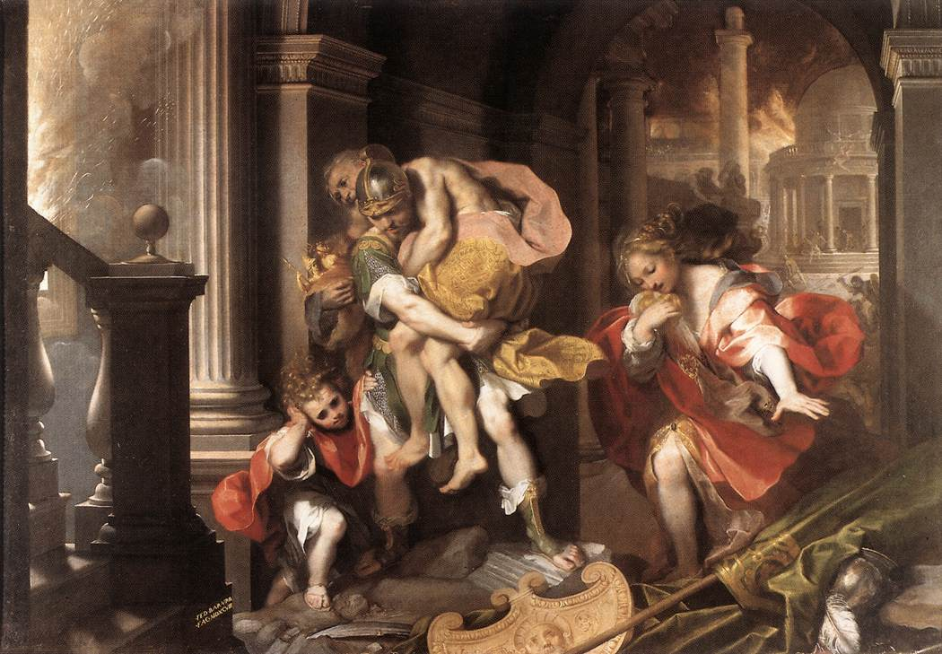
The Aeneid
The Roman epic
Commissioned by Augustus
Modeled on Iliad and Odyssey
Themes of duty, fate

Slide 6
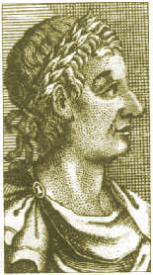
Ovid (43 B.C. – A.D. 17)
Greatest poet of generation after Horace and Vergil
Uninterested in Augustus’s public morality campaign
The Art of Love—how to seduce women

Slide 7
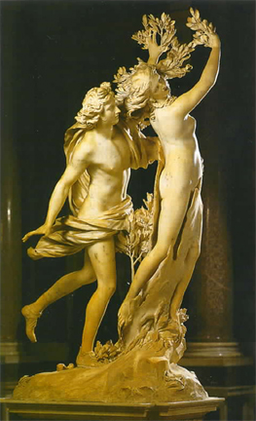
Ovid’s Metamorphoses
One long poem containing over 200 stories
  Mostly mythological tales
  “Changes”
Huge influence on Western literature and culture
  Ovid’s version of myths often the only extant one
  Later writers (e.g. Shakespeare) relied on it heavily

Slide 8
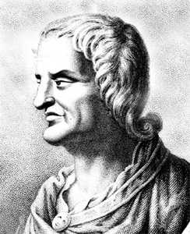
Juvenal (60-140)
Obscure life
Perfected the satire form begun by Horace
Targets of ridicule
  Jews
  Greeks
  Politicians
  Homosexuals
  (Fill in blank)

Slide 9
Historians
Sallust (86-35): Catiline Conspiracy and Jugurthine War
Julius Caesar (103-44): Conquest of Gaul
Livy (64 B.C.- A.D. 12): History of Rome
Tacitus (56-117): Annals and Histories
Suetonius (ca. 75-ca. 130): The Twelve Caesars

Slide 10
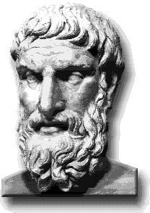
Roman Epicureanism
Review of tenets
Modest influence in Rome
Lucretius (94-49 B.C.)
On the Nature of Things
  Brought many Greek ideas into Latin for first time
  Influenced Vergil

Slide 11
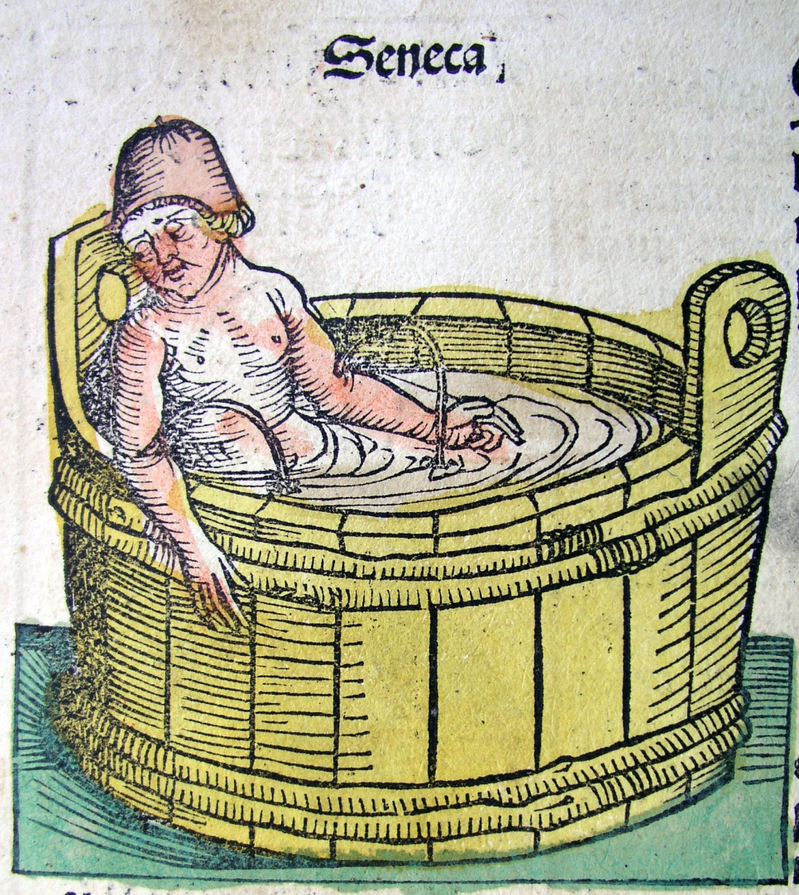
Roman Stoicism
Fit well with Roman sense of honor, duty
Seneca (4 BC-AD 65)
  Official under Nero
  Tragedies
  Philosophical epistles
Marcus Aurelius

