Slide 1
Western Civilization to 1500
Lecture 20: The Pax Romana

Slide 2
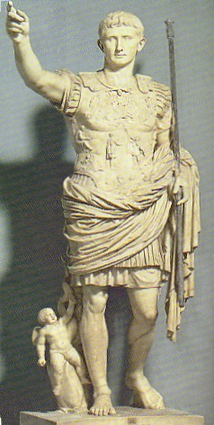
Augustus’s New Order
27 B.C. – “restoration” of Republic by Octavian
Titles
  Augustus
  Princeps
  Pontifex maximus
Foundation of power
  Popularity
  Control of armies

Slide 3
The Army
Functions
  Guarding the frontiers
  Maintaining domestic order
  Apparatus of social mobility and assimilation
Types of soldiers
  Legionaries (150,000) – Italian citizens
  Auxiliaries (130,000) – Non-citizens
  Praetorian Guard (9,000)
Title of imperator

Slide 4
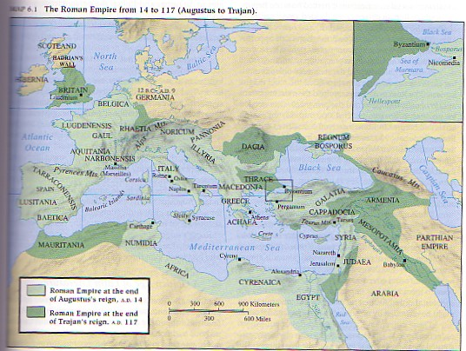
Provinces and Frontiers
New system of appointing governors
Reliance on locals
Frontier policy
  Varus, Arminius

Slide 5
Augustan Society
Social stratification
  Senatorial (1,000,000 sesterces)
  Equestrian (400,000 sesterces)
  Lower classes
Religious revival; imperial cult
Public morality

Slide 6
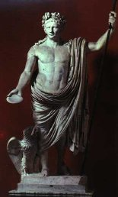
The Julio-Claudians
Legacy of Augustus (27 B.C.-A.D. 14)
Tiberius (14-37)
Caligula (37-41)
Claudius (41-54)
Nero (54-68)
Princeps becomes more imperial; Senate is weakened

Slide 7
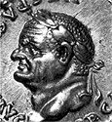
The Flavians
“Year of the four emperors” (69)
King-making armies
Vespasian (69-79)
Titus (79-81)
Domitian (81-96)

Slide 8
The “Good Emperors”
Back to adoption
Nerva (96-98) – instituted the alimenta
Trajan (98-117) – building projects
Hadrian (117-138) – wall in Britain
Antoninus Pius (138-161)
Marcus Aurelius (161-180)
  Stoic
  Meditations

