Slide 1
Western Civilization to 1500
Lecture 19: Roman Culture

Slide 2
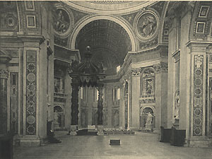
Roman Religion
Focus on ritual, not moral code
Pantheon of gods merged with that of the Greeks
Religious officials
  Pontiffs
  Augurs
Religious festivals

Slide 3
Roman Values
Mos maiorum – traditions of ancestors
Pietas – fulfillment of duty to family, citizens, the gods, and the State
Shift in ideals in 2nd century B.C.
  Affluence
  Status

Slide 4
Roman Law
The Twelve Tables and ius civile
  Foundation of legal system
  Many corrections and additions
Ius gentium – dealt with foreigners
Ius naturale – universal divine law

Slide 5
Influence of the Greeks
Greek teachers – free and slave
Imitation of Greek art and sculpture
Acquired knowledge from the Greeks
  Science
  Philosophy
  Medicine
  Geography
Notes:
One of the unique features of Roman civilization and Western Civilization for that matter, is its relative openness to other absorb and adopt aspects of other cultures to make it their own. This trait is in contrast to Greeks who sought to either avoid other cultures or impose its culture (Hellenism) onto conquered cultures. The Romans certainly did the same. Yet they were not entirely resistant to absorbing what they deemed serviceable to their own needs and desires as witnessed in the almost wholesale adoption of Greek art, philosophy, and science.

Slide 6
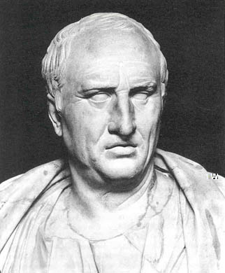
Cicero (106-43)
Greatest Roman orator, Latin stylist
  De Inventione
  De Oratore
Popularizer of Greek philosophy
Political theorist
  De Republica
  De Legibus
  De Officiis

Slide 7
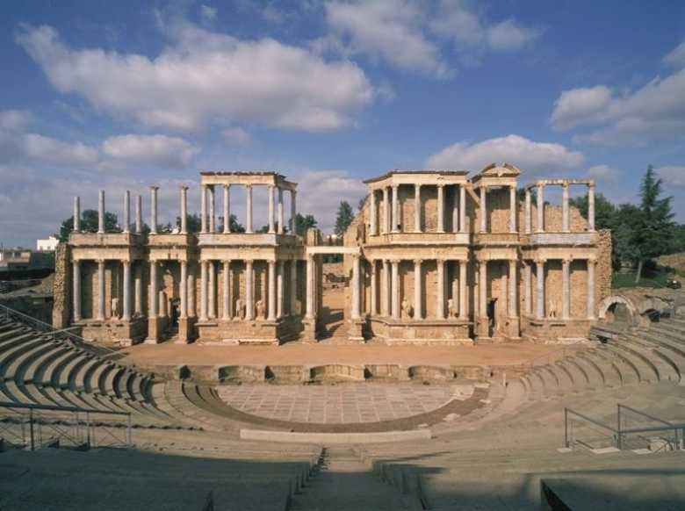
Roman Theater and Art
Roman attitude toward theater
Imitative of New Comedy
Plautus (254-184) and Terence (195-159)
Sculpture: Greek imitation, busts

