Slide 1
Western Civilization to 1500
Lecture 18: Late Roman Republic

Slide 2
Recap
Independence from the Etruscans c. 509.
Struggle of the Orders (494-287)
Expansion
  Latium conquered by 338
  Italy conquered by 246
  Carthage and Corinth in 146

Slide 3
The Republic’s Decline (133-31)
Role of the Senate
Nobiles
Optimates vs. Populares
Equites
Small farmer vs. the latifundia

Slide 4
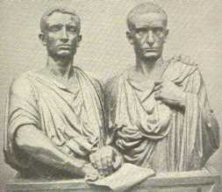
The Gracchi Brothers
Tiberius Gracchus (163-133)
  Conservative?
  Land “reform”
  Assassination
Gaius Gracchus
  Tribune (123-122)
  Revived brother’s policies
  Assassination

Slide 5
Marius and Sulla
Marius (157-86)
  Novus homo and successful general
  5-year consulship
  Military “reforms”
Sulla (138-78)
  Social War (90-88)
  Struggle with Marius and Cinna
  “Restored historic Republic”

Slide 6
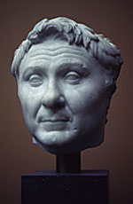
Crassus and Pompey
Populares alliance of Sulla’s men
Crassus (112-53)
  Defeated Spartacus
  Richest man in Rome
Pompey (106-48)
  Eastern campaign
Senate opposition

Slide 7
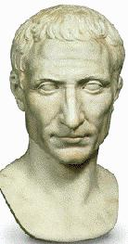
Pompey vs. Caesar
Julius Caesar (100-44)
First Triumvirate (against the Senate)
53 – Crassus dies
Senate sides with Pompey
48 – Battle of Pharsalus
47 – Dictatorship

Slide 8
Octavian vs. Antony
44 – Assassination of Caesar
Second Triumvirate – Octavian, Antony, Lepidus
  “Proscription”
  Hunting of Caesar’s assassins
Cleopatra VII
31 – Battle of Actium

