Slide 1
Western Civilization to 1500
Lecture 17: Early Roman Republic

Slide 2
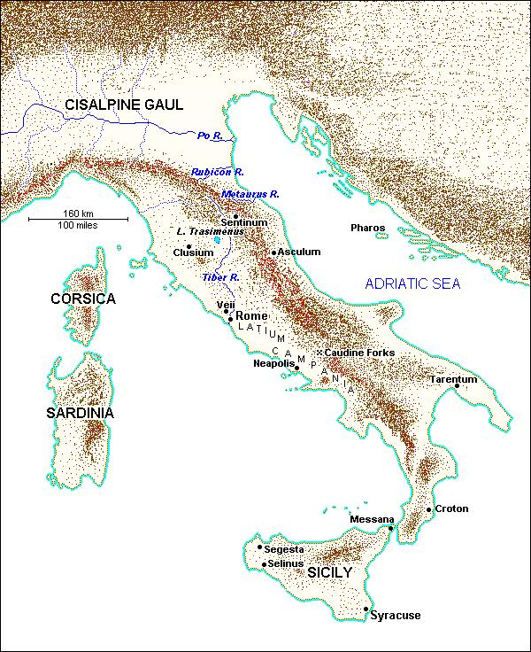
Italian Geography
Mountain ranges
  Alps
  Apennines
Fertile Plains
  Po
  Latium
  Campania
Rome’s Location
  Tiber river
  18 miles inland

Slide 3
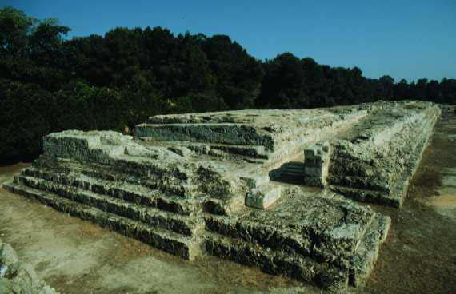
Greeks in Italy
Arrived during Archaic Age
Numerous settlements
Influence
  Olive and vine
  Alphabet
  Cultural model

Slide 4
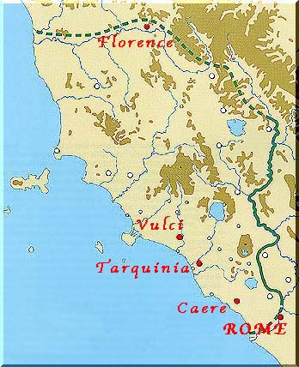
Etruscans
Uncertain origins
Inhabited Etruria
Expanded after 650
  Occupied Latium, including Rome
  Conflict with Greeks
Peaked in the 6th century

Slide 5
Etruscan Influence
Urbanized northern and central Italy
Made Rome into a city
Military organization (hoplites)
Alphabet
Toga and fasces

Slide 6
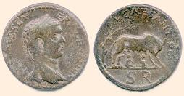
Early Rome
Legendary founding
  Aeneas
  Romulus and Remus
Indo-European language (Latin)
Monarchic period and Etruscan domination
Rape of Lucretia

Slide 7
State and Society
Transition to republic (509?)
Major state elements
  Two consuls and other elected officials
  Senate – small group of large landowners
Family structure and the paterfamilias
Patricians and Plebeians

Slide 8
Struggle of the Orders
Causes
  Plebeians barred from holding office
  Ban on intermarriage between classes
Plebeian gains
  494 – creation of tribunes
  450 – publication of the Twelve Tables
  445 – ban on intermarriage lifted
  367 – consulship opened to plebeians
  287 – Lex Hortensia

Slide 9
Conquest of Italy
493 – alliance with Latin communities
396 – conquest of Veii
387 – defeat by Celts
343-290 – Samnites
290-264 – Magna Graecia
  Pyrrhus of Epirus – “Pyrrhic victory”
Winning Strategies

Slide 10
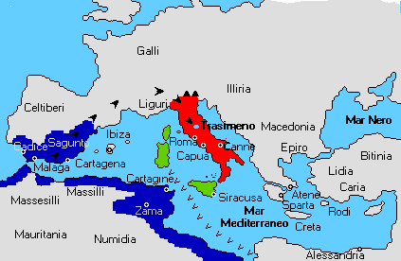
Punic Wars
Carthage
  Founded c. 800 B.C.
  Phoenician colony
  Trade empire in W. Mediterranean
First Punic War (264-241)
  Incident at Messana
  Fight for Sicily
  Roman naval victory

Slide 11
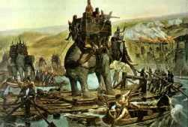
Punic Wars (2)
Carthaginian recovery
Second Punic War (218-202)
  Trouble in Spain
  Hannibal’s march
  Cannae (216)
  Zama (202) – Scipio
Third Punic War (149-146)
  Cato the Elder

Slide 12
The Eastern Mediterranean
219 – Attacks on Illyrian pirates angers Macedonians
216-148 – Four Macedonian Wars
192-189 – Syrian War vs. Seleucids
146 – Destruction of Corinth

Slide 13
Roman Imperialism
No master plan
  Opportunistic expansion
  “Defensive expansion”
Change of motivation in 2nd century
  Economic benefits perceived
  Conquests become more brutal
  Long-term effects on Roman society

