Slide 1
Western Civilization to 1500
Lecture 16: The Hellenistic World

Slide 2
Economy and Society
General prosperity
  Technology stable
  Expansion of commerce
The cosmopolitan
Status of women
Widespread slavery

Slide 3
Culture: Literature
Poetry
  Theocritus (315-250) – “little poems”
  Apollonius of Rhodes (b. 295) – Argonautica
New Comedy: Menander (342-291)
History: Polybius (203-120)

Slide 4
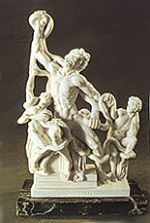
Culture: Art
Realism and emotion, not ideal beauty
  Laocoon

Slide 5
Culture: Science
Astronomy: Aristarchus of Samos
Geography: Eratosthenes
Geometry:
  Euclid
  Archimedes of Syracuse
Medicine:
  Herophilus
  Erasistratus

Slide 6
Epicureanism
Epicurus (341-270)
No active role for gods
Pursuit of pleasure
  Not hedonism
  Freedom from worry and emotional turmoil
No politics

Slide 7
Stoicism
Zeno (335-263) and the Stoa Poikile
Happiness found in virtue
Virtue: following God’s will through your own free will
Acceptance of whatever comes in life
Public service is noble
Influential in Rome

Slide 8
Culture: Religion
Civic religion weakens with polis
Search for personal meaning attracted many to cults
  Syncretism
  Cult of Isis
  Astrology

Slide 9
Hellenistic Jews
Rejected syncretism and cults
Maccabean Revolt (164)
  Antiochus IV (175-163)
  Judas Maccabeus captured the Temple
  Origin of Hannukah
Jews of the diaspora
  Independent corporations within cities
  Cultural assimilation

Slide 10
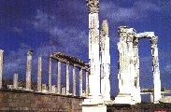
The Hellenistic World
Stagnation or vitality?
Political stability, but lingering problems
Could not withstand the Romans

