Slide 1
Western Civilization to 1500
Lecture 15: 4th-Century Greece and Alexander the Great

Slide 2
Decline of the City-States
Athens recovers after 404, but is never dominant again
Sparta attempts to unite Greeks against Persia but fails
371 – Thebes defeats Sparta
Sporadic intercity warfare and civil war continues until 338
Notes:
Perry describes the post-war situation on p. 69.

Slide 3
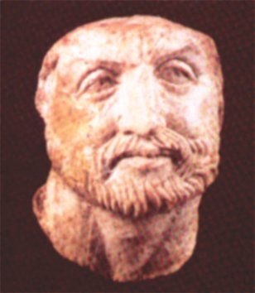
Macedonia
Philip II (359-336)
  Admired Greek culture
  Plan: Unite Greece by force
  Demosthenes and the Philippics
Battle of Chaeronea (338)
Notes:
Perry gives Demosthenes a sidebar on pp. 70-71.

Slide 4
Alexander the Great
Son of Philip of Macedon
Tutored by Aristotle
334 – Invasion of Asia Minor
Several major battles vs. Darius III
  Gaugamela (331) – the decisive battle

Slide 5
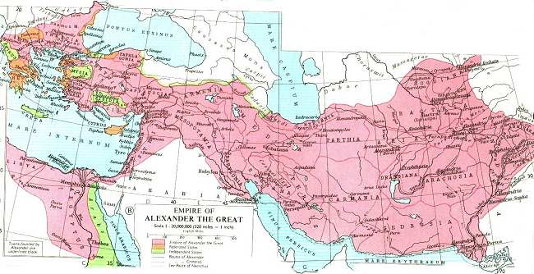
Alexander the Great (2)
Had entire Persian Empire by 330
Continued into India
  Soldiers revolt, Alexander returns
  Died in Susa at 32 (323)
His generals divided his empire

Slide 6
The Hellenistic Monarchies
Macedonia (Antigonid)
Syria and Persia (Seleucid)
Egypt (Ptolemies)

Slide 7
Alexander’s Legacy
Ushered in the Hellenistic period.
Spread Greek culture throughout the known world.
  Greek language (koine) became the common tongue.
  Recreation of the polis in the East
  Greek art, architecture, drama, ideas all spread

