Slide 1
Western Civilization to 1500
Lecture 14: Greek Philosophy II

Slide 2
Plato (c. 429-347)
Student of Socrates: Apology, Crito, Phaedo
The Academy
Dialogues
  Meno
  Symposium
  The Republic
  The Laws

Slide 3
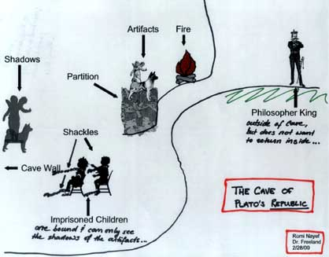
Allegory of the Cave
Metaphysics – What is reality?
Epistemology – What do we know?
Ontology – What is being?
Aesthetics – What is beauty?
Notes:
The allegory of the cave portrays Plato’s dualistic metaphysics of two realms; epistemological idealism (we know by way of the mind, of ideas apart from sensory perceptions; ontology (being) of material objects is less real than the being of the ideals or forms; and aesthetics (theory of art or beauty) in which objects of art are thrice removed from reality (created image of artwork copies the images of objects of this world which are copies of ideals in the realm of the forms.

Slide 4
Plato’s Influence
Whitehead on Plato
Established framework for future inquiry
Showed how to ask the right questions
Interplay with Christianity

Slide 5
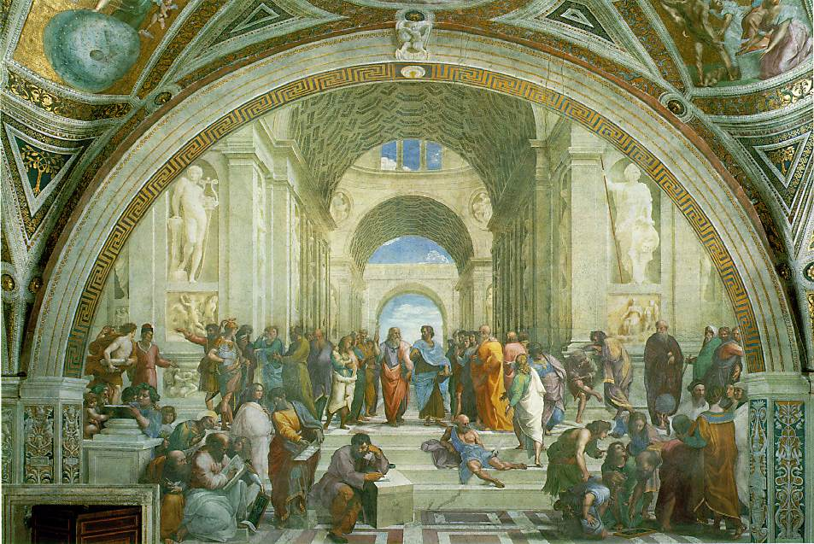
Aristotle (384-322)
Student of Plato
Lyceum
Believed in universals, but rejected division of form and matter
Wrote authoritatively on everything

Slide 6
Aristotelian Ideas
The soul is the form of the body
Levels of friendship
Virtue and happiness found in a “Golden Mean”
The good life found only in the polis
Other Influence
  Formal logic
  Rhetoric

