Slide 1
Western Civilization to 1500
Lecture 11: Greek Culture: Drama and Art

Slide 2
Drama
A Greek creation
Tragedy
  Entertainment
  Catharsis
  Education
City-state competitions

Slide 3
The Tragedians
Aeschylus (525-456)
  Fought at Marathon and Salamis
  Oresteia
Sophocles (c. 496-406)
  Oedipus trilogy
Euripides (c. 485-406)
  More complex characters and plots
  Bacchae

Slide 4
Greek Comedy
Developed later than tragedy
More political than tragedy
  Satire and social commentary
  Targeted politicians and intellectuals
Aristophanes (c. 450 – c. 385)
  Lysistrata
  The Clouds

Slide 5
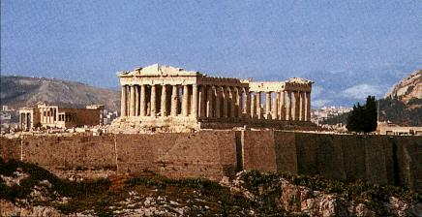
Greek Art
Strove to express true ideals
  Reason
  Moderation
  Symmetry
  Balance
  Harmony

Slide 6
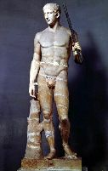
Greek Art (2)
Architecture
  Temples
  Columns
Sculpture
  Goal of ideal beauty
  Flexible, relaxed
  Polyclitus and the canon of proportions

