Slide 1
Western Civilization to 1500
Lecture 10: The Persian and Peloponnesian Wars

Slide 2
Persian Wars
499 – Ionian cities in SW Asia Minor revolt
  Help requested from mainland Greeks
    Sparta refuses
    Athens sends 20 ships
  Temporary success: Sardis burned
494 – Revolt is put down

Slide 3
Persian Wars (2)
Darius invades
  Revenge
  Expansionary vision
Battle of Marathon
  Spartans are delayed.
  Athens and Plataea stand alone.
  Persians are routed.
  Legend of Pheidippides

Slide 4
Persian Wars (3)
Themistocles and the Athenian navy
486 – Death of Darius delays Persian action.
480 – Xerxes invades
  150,000 troops, 700 warships
  Thermopylae: Leonidas and the 300 Spartans
  Salamis
  Plataea (479)

Slide 5
Athenian Empire
Would the Persians try again?
Sparta withdraws to the Peloponnesus
Athens took on “leadership” role

Slide 6
Athenian Empire (2)
478/477 – Delian League organized
  Headquarters on Delos, dominated by Athens
  Smaller states contributed money, not ships
469 – Persians defeated in Aegean
Naxos and Thasos

Slide 7
Athenian Empire (3)
462 – Athens begins mainland expansion
“First Peloponnesian War” (c. 460-445)
  Spartans and allies block Athenian expansion
  Athens agreed to abandon land empire
454 – Delian League’s treasury moved to Athens

Slide 8
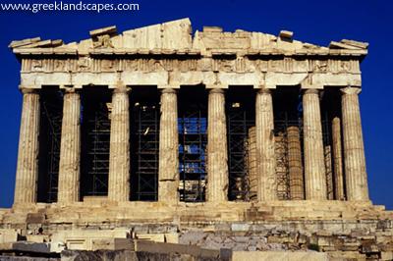
Age of Pericles
Tribute money made Athens rich.
  Shipbuilding
  Public works
461-429 – Pericles in power

Slide 9
Athenian Democracy
Democracy under Pericles
  Lower-class citizens could hold office
  Public offices became salaried
  10 elected “generals” directed public policy
Practice of ostracism
Athenian pride: “Funeral Oration of Pericles”

Slide 10
Peloponnesian War (431-404)
Causes
  Immediate: Athens’s disputes with Corinth and Megara (Sparta’s allies)
  Long-term: Sparta’s fear of Athens’s power
Strategies for victory
  Athens: navy
  Sparta: army

Slide 11
Peloponnesian War (2)
430 – Plague in besieged Athens; 1/3 of population dies.
429 – Pericles dies.
421 – 50-year truce is signed.
415 – War is renewed.
  Alcibiades
  Invasion of Sicily

Slide 12
Peloponnesian War (3)
Sicilian Expedition failed.
  Democracy weakens; oligarchy instituted (410)
405 – Athenian fleet is destroyed
404 – Athens surrenders
  Walls are torn down
  Empire is destroyed

