Slide 1
Western Civilization to 1500
Lecture 9: The Polis

Slide 2
The polis
Geography, population
Acropolis, agora
Comprehensiveness
  Citizen belongs to the polis (Aristotle)
  Local patriotism, rivalries among poleis

Slide 3
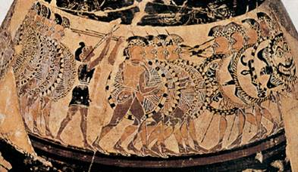
The polis (continued)
Evolution of hoplites
  Heavy infantry
  Phalanx formation
  Required strict discipline
  Replaced aristocratic cavalry and underpinning of heroic code
Military change caused political pressures

Slide 4
Tyranny in the polis
Monarchy ➔ oligarchy
“New rich” left out
Tyrants
  Overthrew oligarchic factions
  Supported by “new rich”
  Above the law
  Cypselus (Corinth)
  Breakdown after a generation

Slide 5
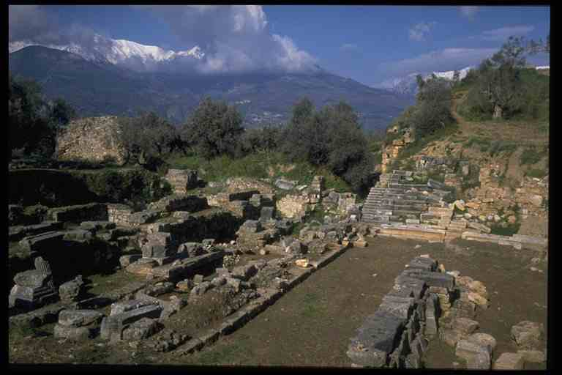
Sparta
In Laconia (SE Peloponnesus)
Expansion (8th-7th c.)
Consolidation
  Lycurgus
  Militarization

Slide 6
Sparta (2)
Life of a Spartan
  Military service (20-60)
  Status of women, mentality of motherhood
Social structure
  Spartan citizens
  Free subjects
  Helots (perpetual state of war)

Slide 7
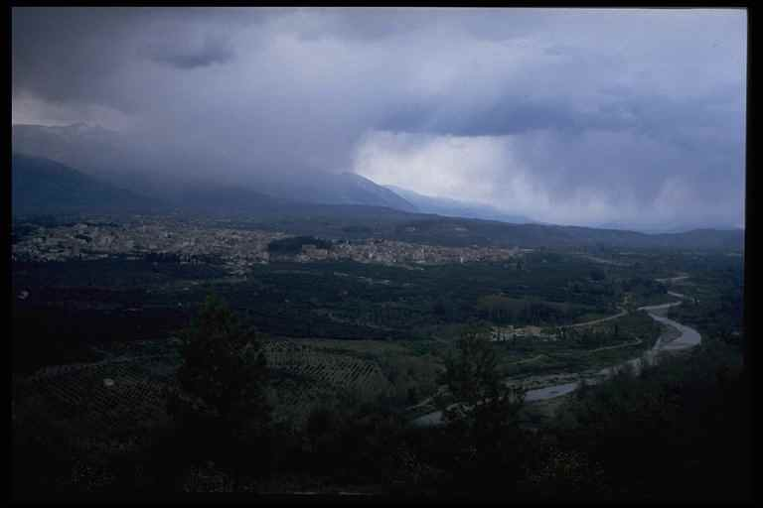
Sparta (3)
Closed Society
  Travel discouraged
  No intellectual or creative pursuits
Peloponnesian League

Slide 8
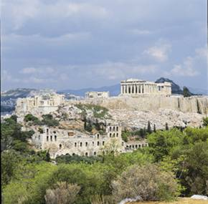
Athens
In Attica
Stages of government
Social discontent
  Rival factions
  Serious economic problems
621 – Draco codifies laws

Slide 9
Athens (2)
Solon’s reforms (594-93)
  Elected sole archon in 594
  Secularized the concept of justice
  Canceled land debts and freed debt slaves
  Divided free Athenians into four classes by wealth

Slide 10
Athens (3)
Move to Tyranny
  Solon’s reforms didn’t solve all the problems.
  560 – Pisistratus seizes power
  510 – Hippias is ousted
Cleisthenes (508-501) and democracy
  Demes
  Office by lottery

