Slide 1
Western Civilization to 1500
Lecture 8: Homer and Archaic Greece

Slide 2
Homer
The importance of the poet in the city
Was Homer a real person?
Head of the literary tradition for Western civilization
The Greeks’ “Bible”

Slide 3
Iliad: Plot
Background
Achilles and Agamemnon
Desperation of Achaeans
Patroclus rallies Achaeans but is killed
Achilles kills Hector, desecrates body
Priam and Achilles
Aftermath

Slide 4
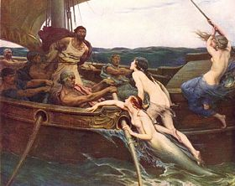
The Odyssey: Plot
Odysseus
  King of Ithaca
  Trojan Horse
Relations with gods
10-year journey home
Wife Penelope and son Telemarchus
Killing of suitors, reunion with family

Slide 5
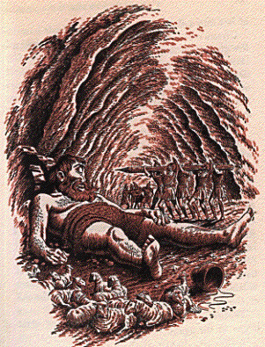
Homeric Themes
War
“Immortality”
Cunning vs. Strength
Seduction vs. Fidelity
Fate and the gods

Slide 6
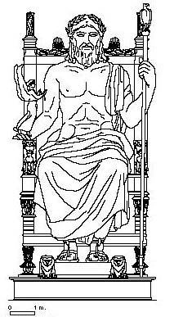
Greek Religion
Social, functional, ritualistic
Temples were the major buildings
Hesiod’s Theogony
12 Olympian Gods

Slide 7
Greek Religion (2)
Each city had a patron god/goddess.
Major festivals: Olympics (776)
Oracles and divination
  Delphi

Slide 8
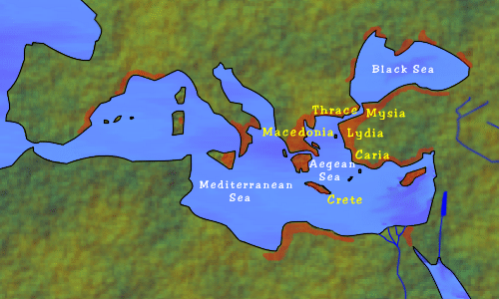
Archaic Age
Revitalization of Greek civilization
Two major developments
  Colonization: Mediterranean, Black Seas
  The polis

Slide 9
Colonization
Reasons
  Land shortage
  Overpopulation
Asia Minor, Black Sea, South Italy, North Africa
“Colonies” really independent
Effects
  Increase in trade
  Spread of Greek culture

