Slide 1
Western Civilization to 1500
Lecture 6: Hebrew Religion

Slide 2
Monotheism
“Hear, O Israel; the Lord thy God, the Lord is One” (Deut 6:4-6)
The challenge of monotheism
  First Commandment
  Polytheistic practices
  Prophets’ denunciations
  Crystallization during Babylonian Captivity

Slide 3
Yahweh: The One God
Creator of the Universe (Genesis)
  Divine ruler and judge
  Omniscient, omnipotent, omnipresent
  Active participant in history
Unseen
  Contrast to other Near Eastern deities
  Second Commandment
Social implications of monotheism

Slide 4
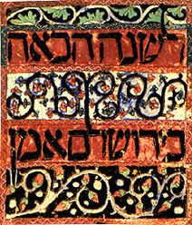
The Hebrew Bible
Pentateuch (Torah)
History
Wisdom Literature
  Psalms
  Proverbs
Prophets

Slide 5
The Covenant
God’s Chosen People
“A Kingdom of Priests” (Ex. 19)
Vehicle of God’s blessings to all people
Special relationship to last for all time

Slide 6
The Law
Expression of God’s Character
Moral code
  The Ten Commandments
  Case laws (Ex. 21-23, etc.)
    Applications of the Ten Commandments
    Economic, political, social regulation
Instructions for Ritual

Slide 7
The Law (2)
Integral to the Covenant
  Obedience brings blessings
  Disobedience brings curses
Fundamental to Hebrew life
  Ubiquity in everyday life
  Periodic public reading of entire law

Slide 8
The Prophets
Prophet/priest distinction
  God ➔ prophet ➔ people
  People ➔ priest ➔ God
Prophetic Function
  Admonitions to Faithfulness
  Warnings of Covenantal Sanctions
  Message of Hope during Captivity
  Universalism

Slide 9
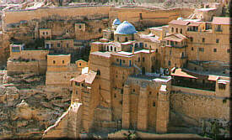
Impact
Monotheism
Christianity and Islam
Model for Western law
Foundation of Western literature
Linear View of History

