Slide 1
Western Civilization to 1500
Lecture 5: Hebrew History

Slide 2
Why the Hebrews?
Contemporary insignificance
Spiritual heritage
Relevance to us

Slide 3
The Genesis Account
Abram/Abraham
  Mesopotamian (Ur of the Chaldees)
  God’s Call; the “Promised Land”
  Genesis 12:1-8
Jacob/Israel
  Abraham’s grandson
  2 wives, 2 concubines, 12 sons, 1 daughter

Slide 4
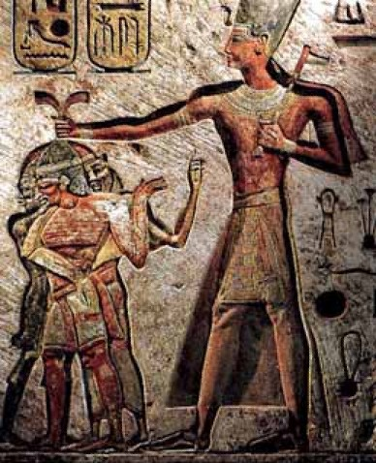
Israel and Egypt
Centuries in Egypt
  Joseph: 11th son of Jacob
  Slavery
The Exodus
  Moses the Levite
  God’s Call (burning bush)
  Ten Plagues
  The Red Sea

Slide 5
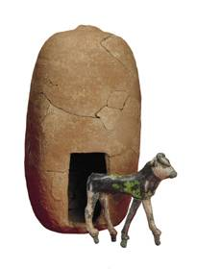
Becoming a Nation
Journey to Sinai
  Ten Commandments
  Golden Calf
Years of Wandering
Invasion of Canaan
  Crossing the Jordan
  Jericho

Slide 6
Period of the Judges
15th-11th centuries (?)
Book of Judges: Cycle of disobedience, judgment, repentance, restoration
Deborah
Gideon
Samson
Samuel

Slide 7
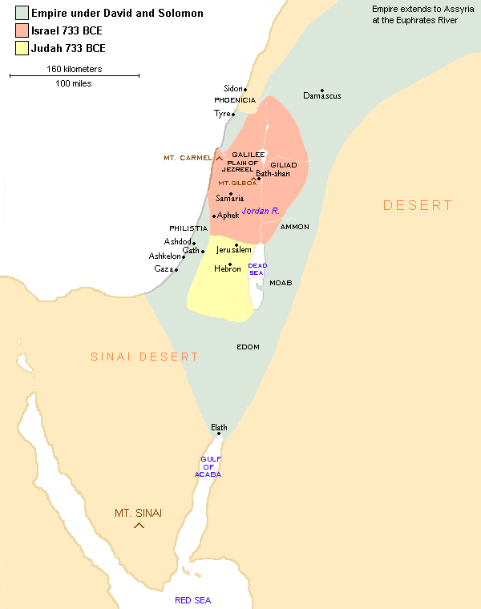
United Kingdom
Call for a King (1 Samuel 8)
Saul (1020-1000) – killed by Philistines
David (1000-970)
  Fight with Goliath
  One of Saul’s lieutenants
  Defeated the Philistines
  Author of many of the Psalms

Slide 8
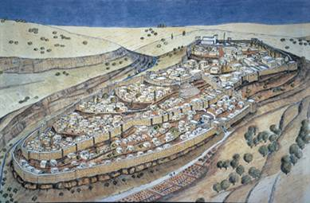
United Kingdom: Solomon
10th century B.C.
Reputation for Wisdom
Building projects (Temple, Palace)
OT author (Proverbs, etc.)

Slide 9
Divided Kingdom
Reign of Rehoboam
  Oppression
  Jeroboam and the northern secession
Northern ten tribes ➔ Israel (Samaria)
  Assyrian Conquest (722)
Southern two tribes ➔ Judah (Jerusalem)
  Chaldean Conquest (586)
  Return under Cyrus (538)

