Slide 1
Western Civilization to 1500
Lecture 4: Empire Builders

Slide 2
The Leftovers
Hittites
Phoenicians
Assyrians
Chaldeans
Lydians
Persians

Slide 3
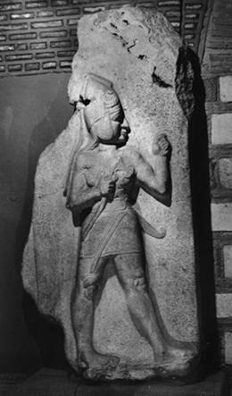
Hittites
Kingdom founded ca. 1750 B.C.
Empire (1450-1200)
Conquered Syria, rivaled Egypt
Destroyed by Sea Peoples
Notable for ironworking

Slide 4
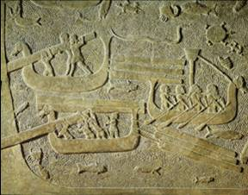
Phoenicians
Maritime and merchant culture
Reached Britain and West Africa
Byblos➔biblos
Inventors of the Alphabet

Slide 5
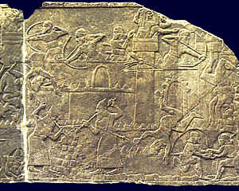
Assyrians
Based in Northern Mesopotamia
Burst of expansion under Tiglath-Pileser I (c. 1155-1077)
Effective army: specialization, terror tactics, deportation of foes

Slide 6
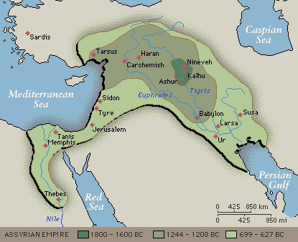
Assyrians (2)
More expansion in the 8th century
Peaked in the mid-7th century ➔
Overextension, rapid collapse
612—Nineveh falls

Slide 7
Chaldeans (Neo-Babylonians)
Rebelled against Assyria, captured Nineveh with Medes
Nebuchadnezzar II (605-562) completed conquests, took Palestine, Egypt
Period of Prosperity
  Agriculture
  Trade Routes
  Industries (textiles and metals)

Slide 8
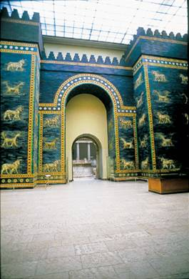
Chaldeans (2)
Babylon the Great
  Ishtar Gate
  Hanging Gardens
  Place in Western consciousness
Babylon falls to Persians in 539

Slide 9
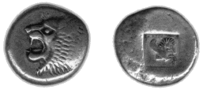
Lydians
Centered in Asia Minor
Relations to Greeks
Croesus
Currency
  Commodity-based
  Precious metals
  Coinage

Slide 10
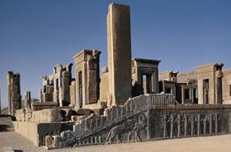
Imperial Structure
Iranian nomads
Cyrus the Great (559-530) and expansion
Decentralized imperial structure (satrapies)

Slide 11
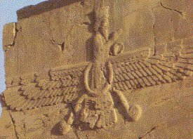
Persian Religion
Originally nature-worship; Mithras
Zoroaster (7th c.)
  Monotheism (Ahuramazda)
  Dualism
Gets watered down

