Slide 1
Western Civilization to 1500
Lecture 3: Ancient Egypt

Slide 2
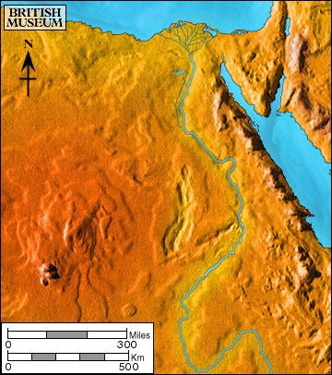
Egyptian Geography
Nile River
  World’s longest
  Floods and irrigation
  “Black Land”
  Herodotus
“Hymn to the Nile”
Source: http://www.ancientegypt.co.uk

Slide 3
Egyptian Geography (2)
“Red Land”
Lower Egypt vs. Upper Egypt
Natural barriers to invasion
Effects: Security and regularity leading to positive outlook

Slide 4
Egyptian Periods (Manetho)
Early Dynastic Period (3100-2700)
Old Kingdom (2700-2200)
First Intermediate Period (2200-2050)
Middle Kingdom (2050-1650)
Second Intermediate Period (1650-1550)
New Kingdom (1550-1070)
Post-empire (1070-30)

Slide 5
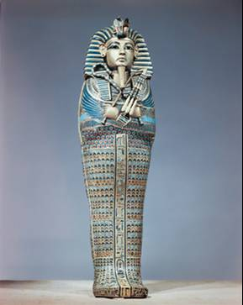
Names to Know
Menes/Narmer
Amenhotep IV/Akhenaten
Tutankhamun
Ramesses II

Slide 6
Society and Economics
Social Hierarchy
  Pharaoh
  Nobles and priests
  Merchants and artisans
  Peasants and serfs
Trade
  Domestic trade along the Nile
  Foreign trade with Nubia, Crete, Syria, Mesopotamia
  Products: stone dishes, papyrus, linen, metalwork

Slide 7
The Egyptian State
Divine kingship—the pharaoh as God
Concept of ma’at
Office of vizier
Heavy taxation

Slide 8
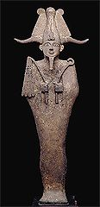
Egyptian Religion
Numerous gods
  Re (Ra)
  Osiris, Isis, Horus
Myth of Osiris’s death and rebirth
Osiris as judge of the dead

Slide 9
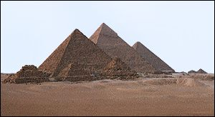
The Pyramids
Built in Old Kingdom
Purposes
  Tombs for pharaohs
  Symbols of royal power
Craftsmanship and precision

Slide 10
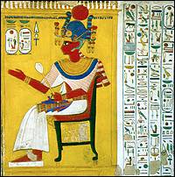
Egyptian Art and Writing
Spiritual purpose of art
  Aid to ritual
  Aid to the dead
Hieroglyphics
Papyrus

Slide 11
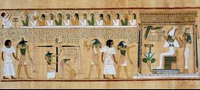
Egyptian Literature
Predominantly religious
Book of the Dead
  “Negative Confession”
Abydos Passion

Slide 12
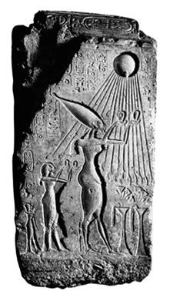
Egyptian “Monotheism”
Amenhotep IV (14th century B.C.)
Sun god Aten
“Akhenaten”
(Non)influence
Akhenaten and Moses (?)

Slide 13
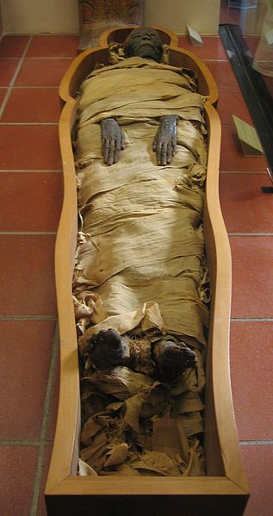
Egypt’s Impact
Ancient and Modern Awe
Direct Influence Uncertain
“Black Athena” Thesis

