Slide 1
Western Civilization to 1500
Lecture 2: Mesopotamia

Slide 2
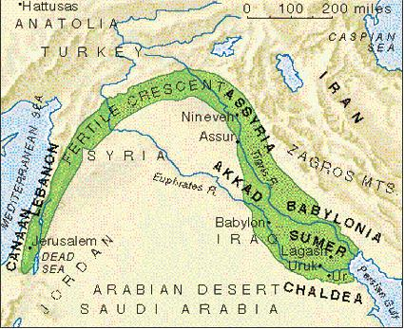
Mesopotamian Geography
“Fertile Crescent”
“Land between the rivers”
  Tigris
  Euphrates
  Modern Iraq
Unpredictable floods
No natural boundaries

Slide 3
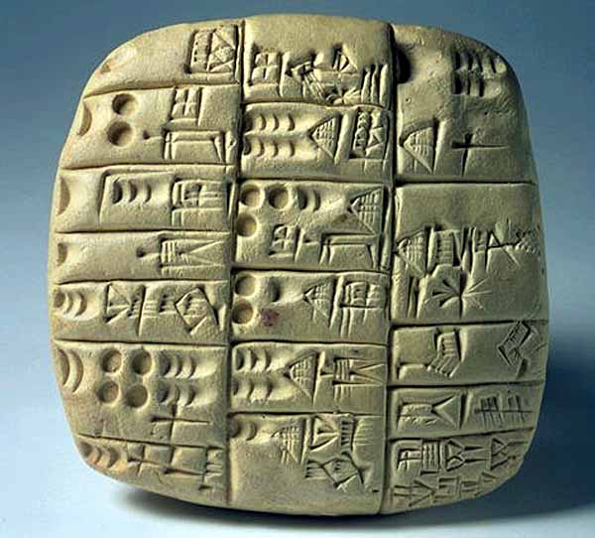
Rise of Civilization
Agricultural Technology
  Wheel
  Plow
  Irrigation
Writing: cuneiform (pictographic)

Slide 4
Social Organization
City-states (Sumer)
Kings as divine representatives
Competition and warfare
  Land
  Water rights
Castes
  Nobles (royal and priestly)
  Commoners (farmers, merchants, artisans)
  Slaves (of kings and priests)

Slide 5
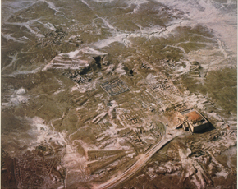
Overview of Ur with Ziggurat

Slide 6
Sumerian Religion
Polytheistic and animistic
Gods sponsored city-states
Capricious gods
Sacrificial system
  Propitiation of the gods
  Function of temples, ziggurats
  Role of priests

Slide 7
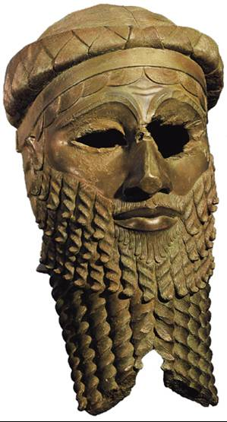
Current Consensus Chronology
Ca. 3000: rise of Sumer
24th Century: Akkadian conquest
City-states vs. Empire, Invasions
Ca. 1790-Hammurabi’s reign begins

Slide 8
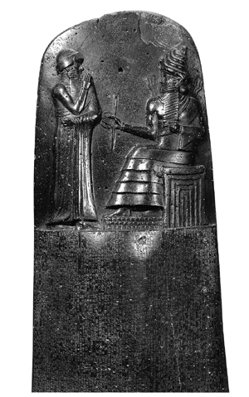
Law: The Code of Hammurabi
“Eye for eye, tooth for tooth”
Punishment varied according to caste
Social and Economic regulations
  Price controls
  Inheritance rules
Officials’ duties

Slide 9
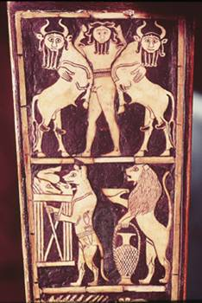
The Epic of Gilgamesh
Discovery in mid-19th century
Characters
  Gilgamesh
  Enkidu
  Ishtar
  Utnapishtim
Themes
  Civilization
  Friendship
  Meaning of Life

Slide 10
Science
Mathematics
  Base-60 number system
  Multiplication, division, interest tables
  Practical geometry (fields, architecture)
Astronomy
  Charted constellations
  Lunar calendar of twelve months

